Slide 1

TOPIC- LibreOffice Calc
COURSE: CCC
CHAPTER: 03 (CALC)
NIELIT
Presentation By : Shruti Dubey

Slide 2
Syllabus
Elements of Spread Sheet, Creating of Spread Sheet, Concept of Cell Address [Row and Column] and selecting a Cell, Entering Data [text, number, date] in Cells, Page Setup, Printing of Sheet, Saving Spreadsheet, Opening and Closing, Manipulation of Cells & Sheet, Modifying / Editing Cell Content , Formatting Cell (Font, Alignment, Style ), Cut, Copy, Paste & Paste Special, Changing Cell Height and Width, Inserting and Deleting Rows, Column, AutoFill, Sorting & Filtering, Freezing panes, Formulas, Functions and Charts, Using Formulas for Numbers (Addition, Subtraction, Multiplication & Division), AutoSum, Functions (Sum, Count, MAX, MIN, AVERAGE), Sort, Filter, Advanced Filter, Database Functions ( DSUM, DMIN, DMAX, DCOUNT, DCOUNTA), What-if M Analysis, Pivot table Charts (Bar, Column, Pie, Line), Data Validation.

Slide 3
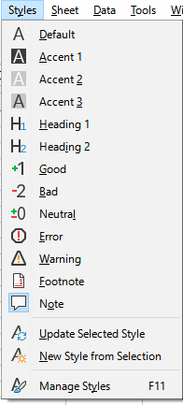
Style Menu

Slide 4
Sheet Menu
This menu contains commands to modify and manage a sheet and its elements.
Insert Rows
Insert rows above or below the active cell.
Insert Columns
Inserts columns to the left or to the right of the active cell.
Insert Page Break
This command inserts manual row or column breaks to ensure that your data
prints properly. You can insert a horizontal page break above, or a vertical page
break to the left of, the active cell.
Delete Cells
Completely deletes selected cells, columns or rows. The cells below or to the right
of the deleted cells will fill the space. Note that the selected delete option is
stored and reloaded when the dialog is next called.
Delete Page Break
Choose the type of page break that you want to delete.

Slide 5
Sheet Menu
Fill
Automatically fills cells with content.
Deleting Contents
Specifies the contents to be deleted from the active cell or from a selected cell
range. If several sheets are selected, all selected sheets will be affected.
Move or Copy Sheet
Moves or copies a sheet to a new location in the document or to a different document.
Show Sheet
Displays sheets that were previously hidden with the Hide Sheets command.
Delete Sheet
Deletes the current sheet after query confirmation.
Sheet Tab Color
Opens a window where you can assign a color to the sheet tab.
Sheet Events
Assigns macros to program events. The assigned macro runs automatically every
time the selected event occurs.

Slide 6
Thank You
NIELIT
Presentation By : Shruti Dubey

